Slide 1
Communication:
Communication theories
Definitions
Communication Types:
inter, intra, public, mass
Internal, external, upward and downward

Slide 2
OBJECTIVE:
Understanding of the concept of Communication from a technical and scientific perspective

Slide 3
Point to ponder.
Read the given quote and give your opinion.
What is meant by the speaker when he says:
"I know that you believe you understand what you think I said, but I'm not sure you realize that what you heard is not what I meant."
Robert McCloskey

Slide 4
“People don’t get along because they fear each other. People fear each other because they don’t know each other. They don’t know each other because they have not properly communicated with each other.” Martin Luther King Jr.
Why, do you thin Luther king said the following?

Slide 5
Task 2
Read the definitions given in the handout and share them with the class.
List down the key expressions/adjectives.

Slide 6
DEFINITIONS OF COMMUNICATION.
“Communication is any behavior, verbal or non-verbal, that is perceived by another. Knowledge, feelings, or thoughts are encoded and sent from a source and received and decoded by another. A connection is made between the people communicating.”
“Communication is a dynamic process that individuals use to exchange ideas, relate experiences, and share desires through speaking, writing, gesture, or sign language.”

Slide 7
Summarizing the definitions
Technically speaking, in the act of communication, we make opinions, feelings, information, etc. known or understood by others through speech, writing or bodily movement.

Slide 8
PURPOSE:
Why do we communicate?
The purpose of any given communication may be:
a) to initiate some action: Expressing needs and requirements, Persuading and motivating others
b) to impart information, idea, attitudes, beliefs or feelings:
a) Creating awareness
b) Creating understanding
c) Persuading others
d) Influencing others
c) to establish, acknowledge or maintain links or relations:
Core function of communication.

Slide 9
The Essence of Communication
Personal process
Occurs between people
Involves change in behaviour
Means to influence others
Expression of thoughts and emotions through words & actions.
Tools for controlling and motivating people.
It is a social and emotional process.

Slide 10
Features of Communication
Two-way Process
Information Sharing and Understanding
Circular Flow
Goal Oriented
Continuous Process
Pervasive/extensive Activity.

Slide 11
HISTORY OF COMMUNICATION
Communication is as old as civilization itself. It is interesting to note how communication has developed through time. The table below summarizes the progress made by communication along history very briefly.
Time | Speech | Writing
Early | Domestic/Social | Pictographs (pictures on stones)
Mid-Time | Public Speaking started developing. | Writing on papyrus, wax, clay tablets
Today (The Age of Media) | Sophisticated system | Writing on paper, computer documents

Slide 12
The Basic Communication Process:
This eight-step model is a simplified view of how communication works in real life; understanding this basic model is vital to improving your communication skills.

Slide 13
THEORIES OF COMMUNICATION.
1. Electronic or mathematical Theory :
The message begins with an information source-the mind of the sender (writer or speaker), who encodes a message into words and sentences.
The message is transmitted as a signal (marks on paper or sound waves) through a channel, where it may be distorted by noise (such as smudged typing or acoustical problems). As a last step, the receiver (listener or reader) decodes the message.

Slide 14
THEORIES OF COMMUNICATION.
2. Social Environment Theory:
Communication takes place in a social setting where the given context plays it’s role. Interlocutors take roles holding a status where “culture” has its part.
• Within that situation, each agrees to assume certain roles – such as “compromiser,” “initiator,” “or “encourager” – based on his/her part in the activity.
Rules: official- such as company policies and practices – and those unwritten rules
regarding to whom, how, and when, and for how long it is appropriate for us to communicate
within a certain organization.

Slide 15
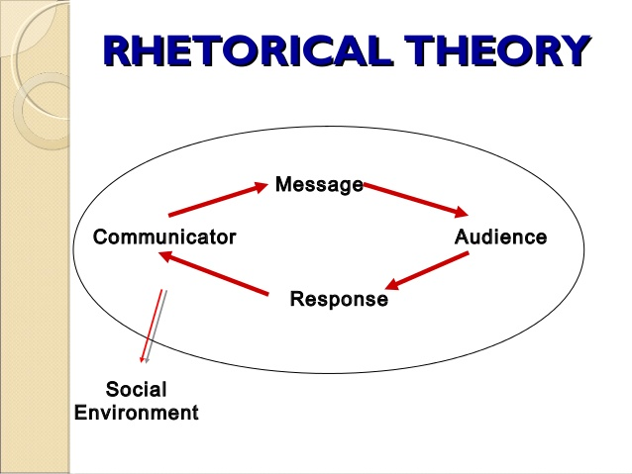
THEORIES OF COMMUNICATION.
3. Rhetorical Theory:
It suggests that communication is not linear or static, but dynamic and circular; not just sending a message to be received, but producing a response is desired.
Many people caught up in the accuracy forget third crucial variable, producing the desired response form their audience.

Slide 16
FORMS OF COMMUNICATION
Verbal
Non verbal
graphic

Slide 17
Forms of Communication
1. VERBAL COMMUNICATION:
Verbal form can either be spoken or written. It involves the use of words.
Consists of speaking, listening, writing and reading.
Takes place through face to face conversation, group discussions. Counselling, interviews etc.
ADVANTAGES Makes immediate impact ➢ Provides opportunity for interaction and feedback ➢ It is very fast and non-expensive ➢ Help us to foster better relationships with co-workers and friends. ➢ Used to inform, inquire, argue and discuss topic of all kinds

Slide 18
Forms of Communication
2. NON-VERBAL:
In this form, words or graphics are not employed. It is present in written, oral, and graphic communication(TONE).
It involves the use of body language, paralanguage (intonation, pitch, expressions, hesitation) and dressing in speech. format, layout, handwriting style, etc are non-verbal elements in writing.
ADVANTAGES ➢ Helps to communicate with deaf. ➢ Helps to communicate in silent zones ➢ Captures feelings and emotions.

Slide 19
Forms of Communication
3. GRAPHIC COMMUNICTION:
It represents ideas, feelings, views, etc visually by the use of shapes, diagrams, lines, symbols, illustrations, color, etc. It can have both verbal and non-verbal elements.
It is the process of creating , producing, and distributing material incorporating words and images to convey data, concepts and emotions.
Graphic aids present information in pictorial form or in other specific formats in order to consolidate, clarify or prove the written material they go with.
TYPES OF GRAPHIC AIDS.
PHOTOGRAPHS, TIMELINES, POSTERS, CHARTS, DIAGRAMS, DRAWINGS, MAPS, CARTOONS, FLASH CARDS and GRAPHS etc.

Slide 20
Types of Communication
1. INTERPERSONAL:
It involves interaction between people on a one-to-one basis or a one-to-many basis.
2. INTRAPERSONAL:
In this, you think about, learn about, reason with, and evaluate yourself. It includes use of one’s mental faculties for a better understanding of oneself as well as the world.
3. TELEPHONIC COMMUNICATION:
It uses a telephonic or any other advanced medium for communication between participants.

Slide 21
Types of Communication
4. PUBLIC COMMUNICATION:
It involves informing and persuading the members of an audience to hold certain attitudes, values, or beliefs, so that they will think, believe, or act in a particular way; on the other hand, you can also function as a member of an audience, in which case another person will do the same for you.
5. ORGANIZATIONAL COMMUNICATION:
It generates from one source and takes place when the organization communicates with a number of receivers. This kind of communication can be made either to receivers within the organization, or to others outside the organization in the form of reports or meetings.

Slide 22
Types of Communication
6. MASS COMMUNICATION:
Mass communication is communication between mass media (electronic and print) and the public.

Slide 23
Formal vs Informal communication.
Formal
Planned communication
Memo, letter, report, e-mail & faxes that follow company’s chain of command etc.
Informal
Casual Communication among employees
e-mail face to face conversation, phone calls, discussions etc.

Slide 24
Formal Communication Network
The formal communication network is defined by the relationships between the various job positions in the organization.
Messages can flow upward (from a lower-level employee to a higher-level employee), downward (from a higher-level employee to a lower-level employee), and horizontally (between employees at the same or similar levels across the organization).

Slide 26
Communication can be thought of as a problem solving activity in which individuals may address the following questions:
What is the situation?
What are some possible communication strategies?
What is the best course of action?
What is the best way to design the chosen message?
What is the best way to deliver the message?

Slide 27
Home Task
Read page number 1 to 4 from the handout shared on google classroom.

